Slide 1
CEC’s PowerSchool On-Line Class Registration Information 2020- 2021
On February 20th, 2020, CEC will be initiating on-line class registration for incoming Grade 12’s

Slide 2
Parent/ Student Portal
If you don’t have a Power School Portal Log In and password, please see Morgan in Student Services for parents, or Mrs. Campbell in Main Office for Students.
Once access given, go to Power School Portal Link and click here to log on to the Power School Parent/ Student Portal.
Complete the Worksheet provided/ and Credit Check sheet before you begin your on-line Registration.
Keep in mind the Credits and Subjects needed for Graduation, located on Page 6-7 of the 2020-2021 Course Selection Guide.
Once All the courses have been chosen- min 3- max 8; you must select 2 alternative courses. If a class is full or cannot fit into the schedule, these alternatives will come into play.
If you wish to try and finish all your graduation requirements by First Semester, please let Morgan know in student services, by March 27th- we will try our best to make it happen.

Slide 3
Register On-Line
After logging in, you will see your student’s current courses and grades. To access the on-line scheduling area, just click on Class
Registration on the left side of the page. With your worksheet completed, you are ready to begin.
There are directions directly below the subject name to aid with choices.
Subjects that have the red exclamation point on the right, must be selected.
The green check means that a course choice is optional.
The “SUBMIT” button will not work unless there are only green check marks on the right, including the correct number of credit hours.

Slide 4
Just follow these easy steps to complete each subject:
Click on the pencil on the right
Click on the box to the left of the course name of your choice.
Click Okay and move on to the next subject. This is where that worksheet will come in handy!
Note that a box with the name of the course you’ve chosen appears. This will help you keep track of which subjects have been completed as well as the check marks.
PLEASE NOTE: The prerequisites for each course are listed, and a course will not be an available choice if pre-requisites have not been met.
If you require Special Section courses such as Music12Band,CanHis11S, GGS12S, Law12S, MKS11S, OCNS11S, BIOL11S, PAL11 all girls, Learning Strategies, Social Literacy 11 or Resource Ctr please see next slide…
Make sure to choose your alternate courses.
When you have finished making your choices, you must click the SUBMIT button!!! Don’t forget this step, or none of your work will be saved!
You will then see a list of the courses you have chosen. If there is an error, or something is missing, you can return to the subject choice page by just clicking on Class Registration again.
Changes can be made, just don’t forget to SUBMIT!
Counsellors are available in Library for individual help, during lunch hour for next couple of weeks, or you may make an appointment with a Counsellor in Student Services to discuss your choices. You have plenty of time to complete the form, talk to a counsellor, and edit your choices. Course changes close April 24th , 2020.

Slide 5
CEC Online Registration Grade 12:
SPECIAL SECTION FORM
To access the Special Section Form, please copy and paste the following URL into your browser, (do not use Internet Explorer), complete and submit online by hitting the Send button at top of Form:
https://forms.gle/VZJvEGMQeHzdgksR9
Special Section Form is for any of the following courses:
  Oceans 11 Support
  Biology 11 Support
  MKS11 Support
  Canadian History 11 Support
  Global Geography 12 Support
  Law 12 Support
  Physically Active Living 11 All Female
  Resource Ctr or Learning Strategies 11 or 12
  Social Literacy 11
  Music 12 Band

Slide 6
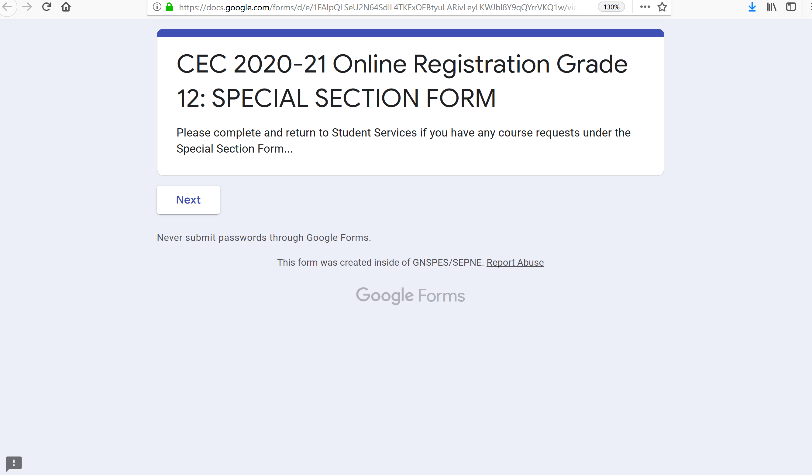
The Special Section Form looks like this…

Slide 7
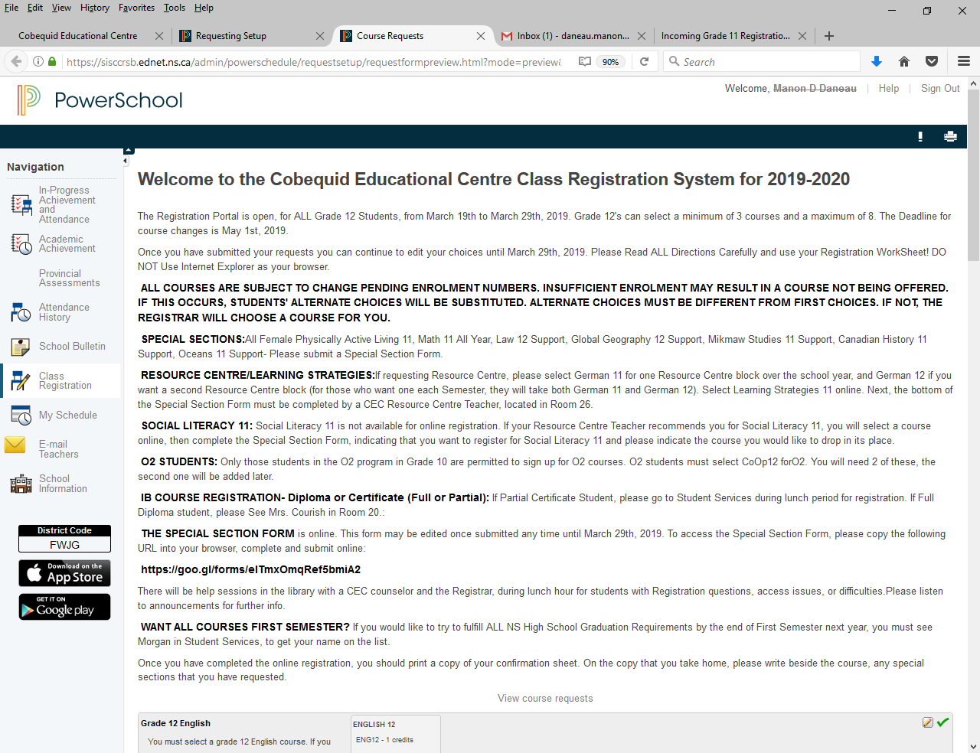
Once you log in to the Portal, you will go to the Class Registration Tab on the left hand side, and you will see the following…
2020-21

Slide 8
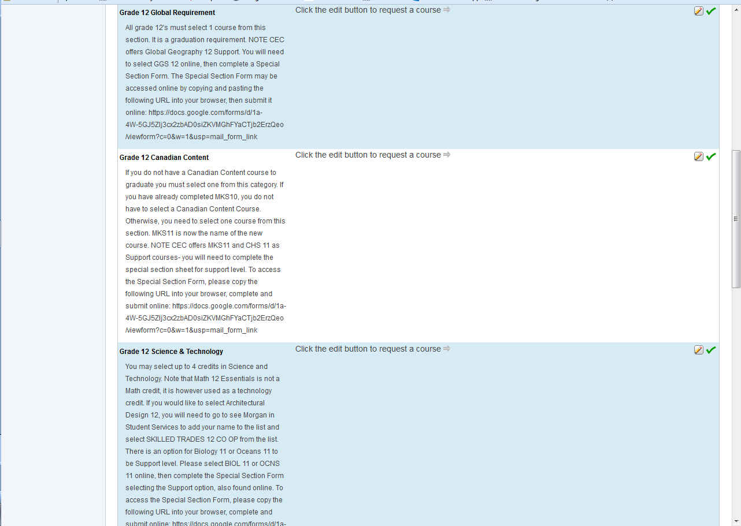
The screen continues with other selections- note the green check as perhaps you already have your Canadian Content course in Grade 10, or have already fulfilled Science/ Technology credit- but you may choose to take others.

Slide 9
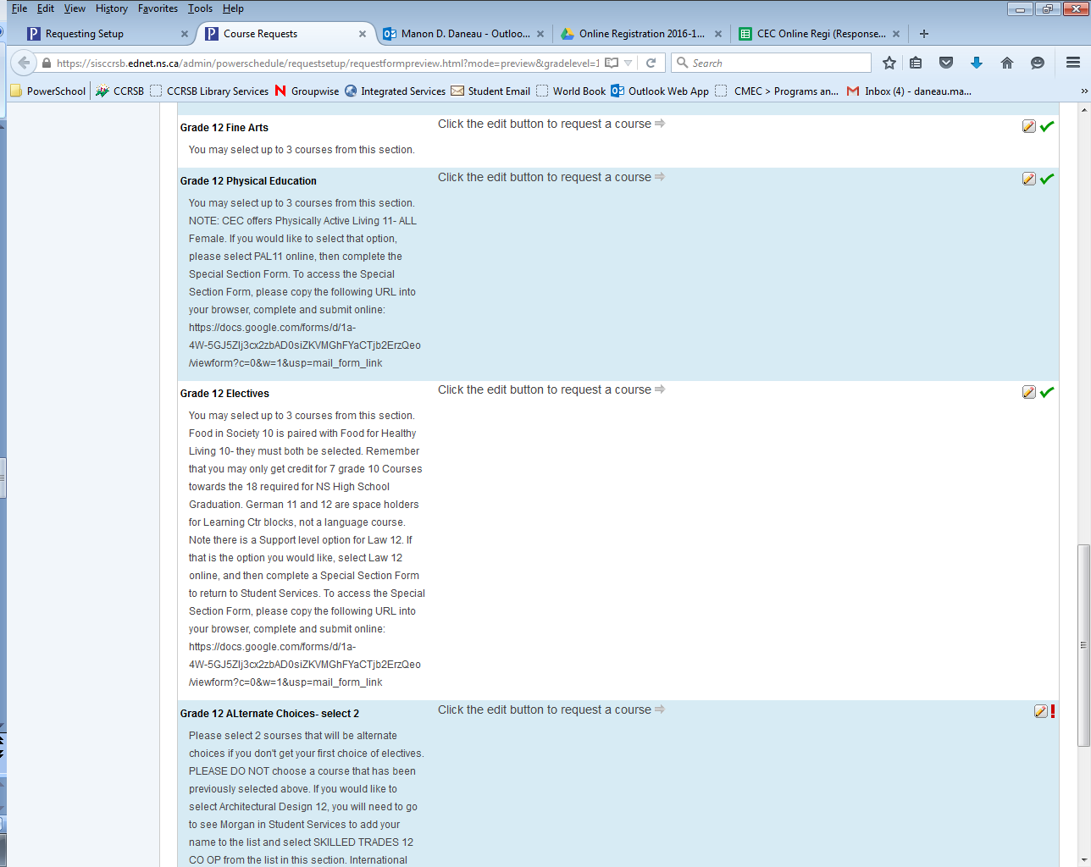
More selection choices- Fine Arts, Phys Ed, Electives, and Alternate Choices- must pick 2 second choices, not already selected from above.

Slide 10
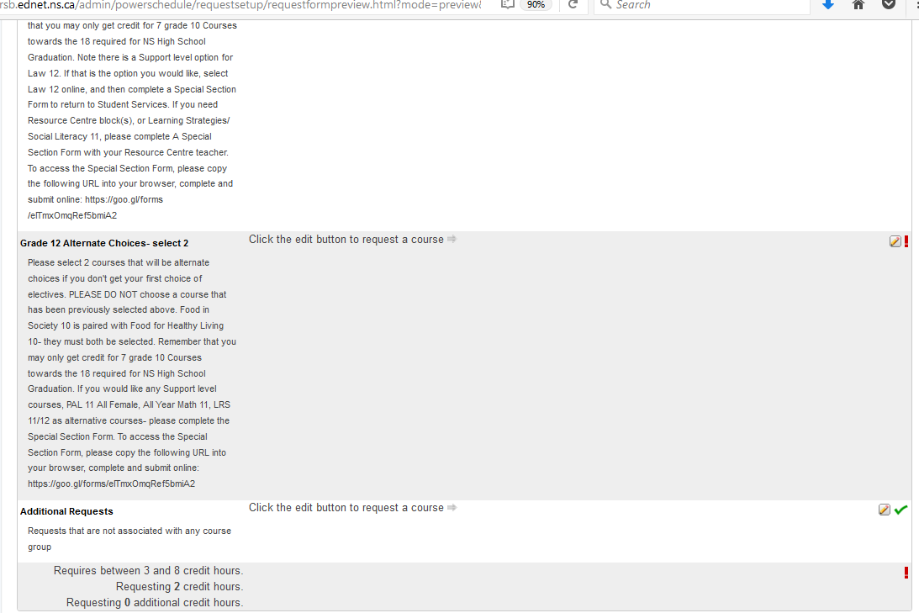
At the bottom you will find the section where you have to pick 2 other Alternate courses, just in case your first choice is full or does not schedule. Please note the total Required Credit Hours will say between 3 and 8, and Requesting is the running total (2 in this example).

Slide 11
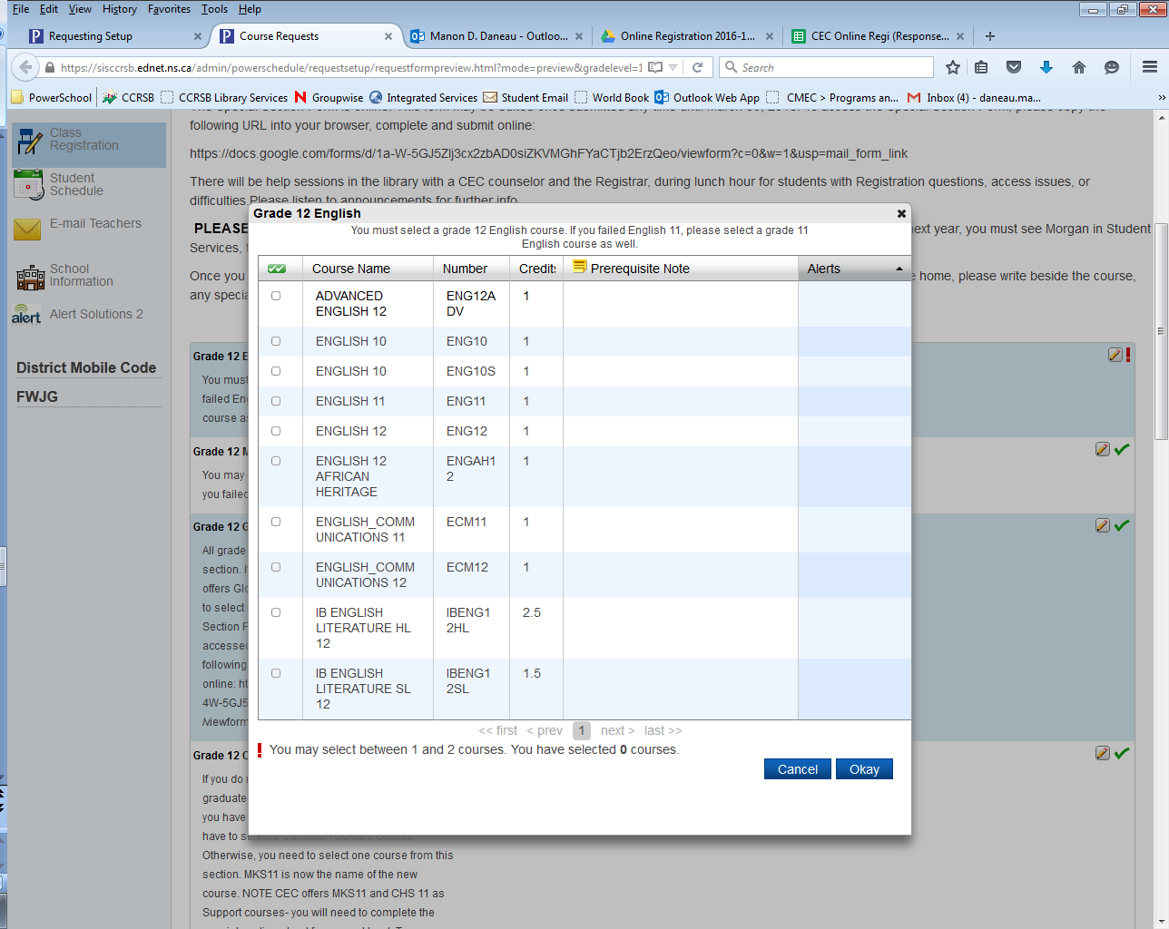
English Options- click on pencil by Grade 12 English and will see the following…

Slide 12
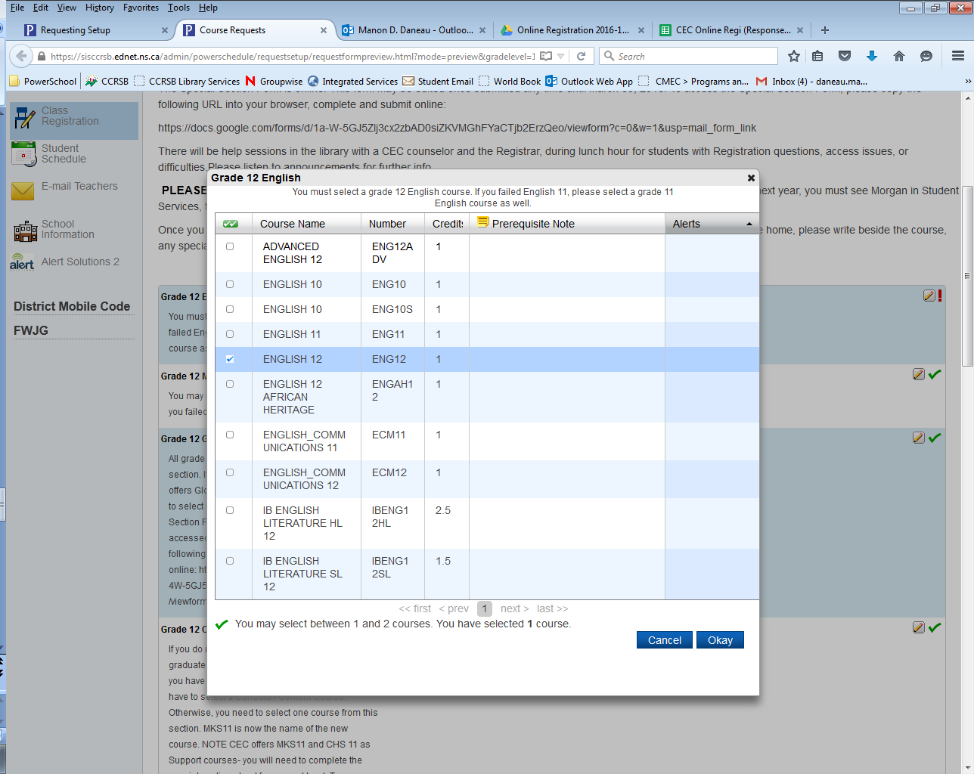
Select the course you want by clicking on the box next to it- in this example ENGLISH 12 was the choice. Note the Green Check that appears below, if you failed ENG11 last year, you will have to do both an ENGLISH 11 AND 12 CREDIT.

Slide 13
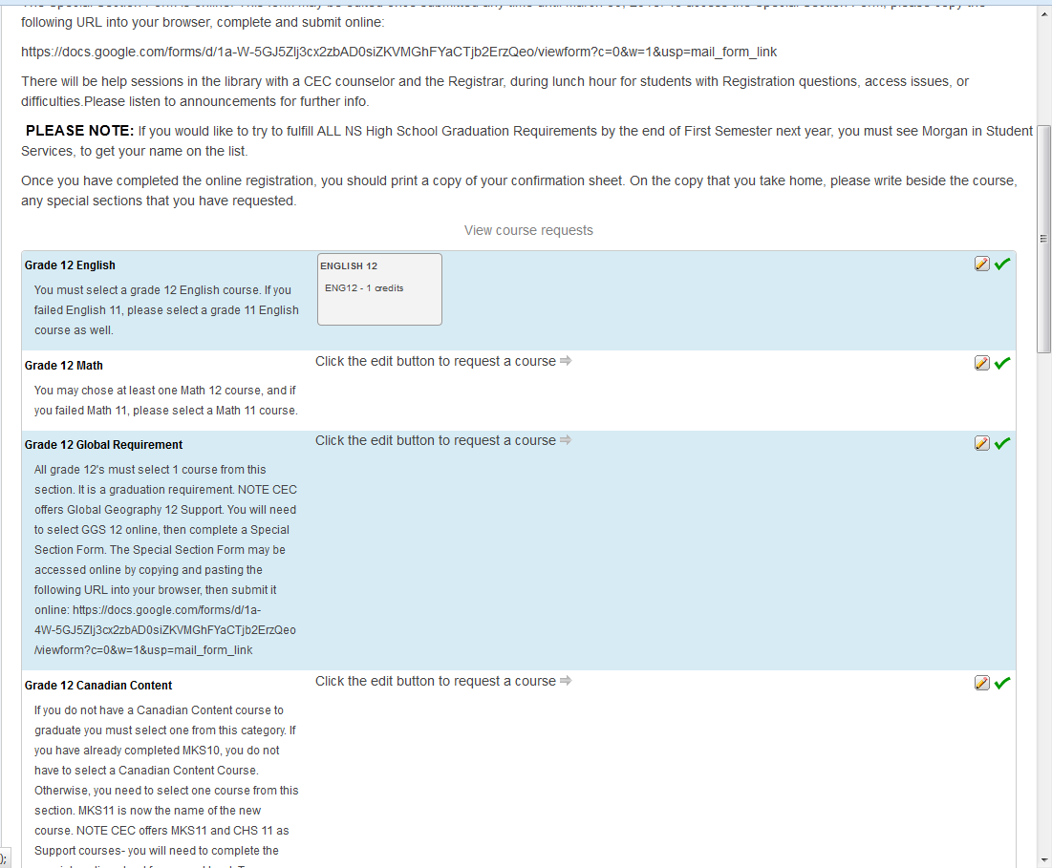
Once you click Okay, you will see the course appear in the English section… and…

Slide 14
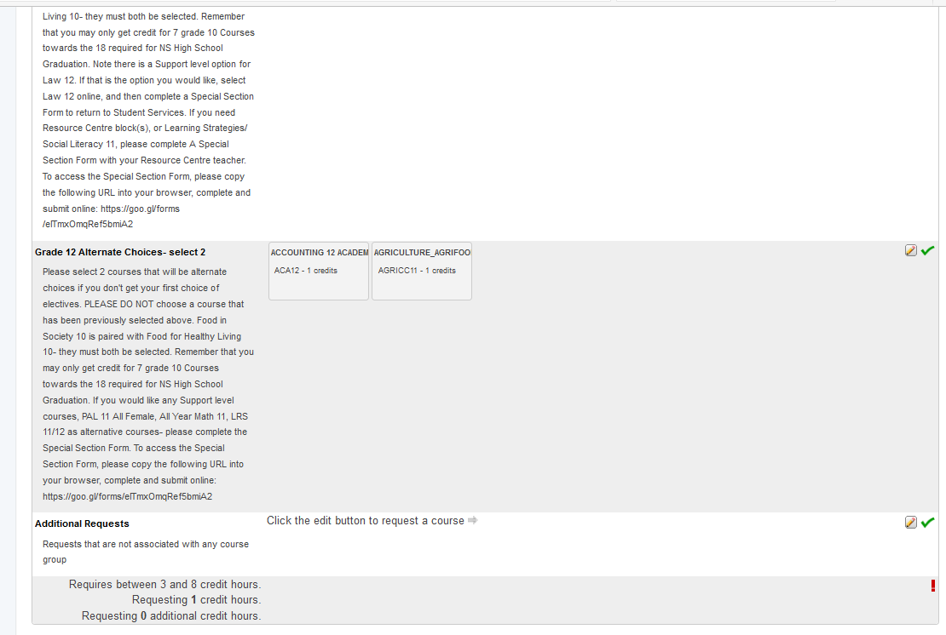
…and the total below changes. I have chosen 1 English course, and 2 alternative choices below. The Red exclamation mark has changed to a green check by the Alternate Choice Section. Total Requesting credit hours shows 1.

Slide 15
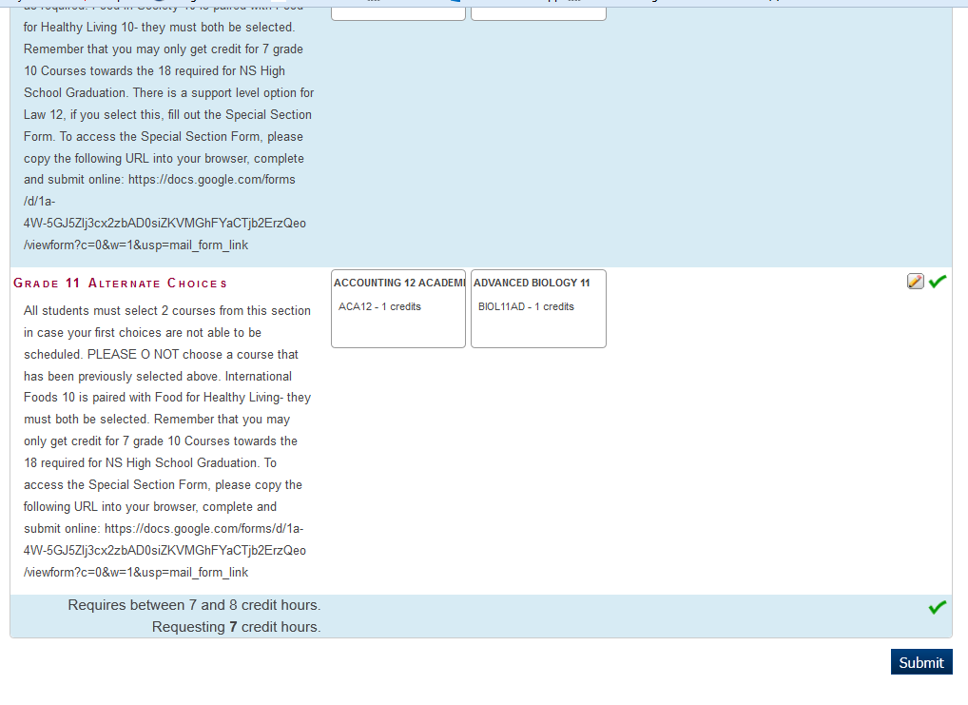
Ready to Submit:
Once you have all 3 to 8 courses and the 2 Alternate courses selected, the Red exclamation mark at the bottom will change to a Green check mark and you may now click submit to save your choices. You may go back at anytime until the due date and edit your choices.
Please Hit Submit button when you have completed all your Course Selections, Alternate Choices, and if you had to complete a Special Section Form.
Requires between 3 and 8 credit hours for grade 12s.
Requesting 7 credit hours.

